Slide 1

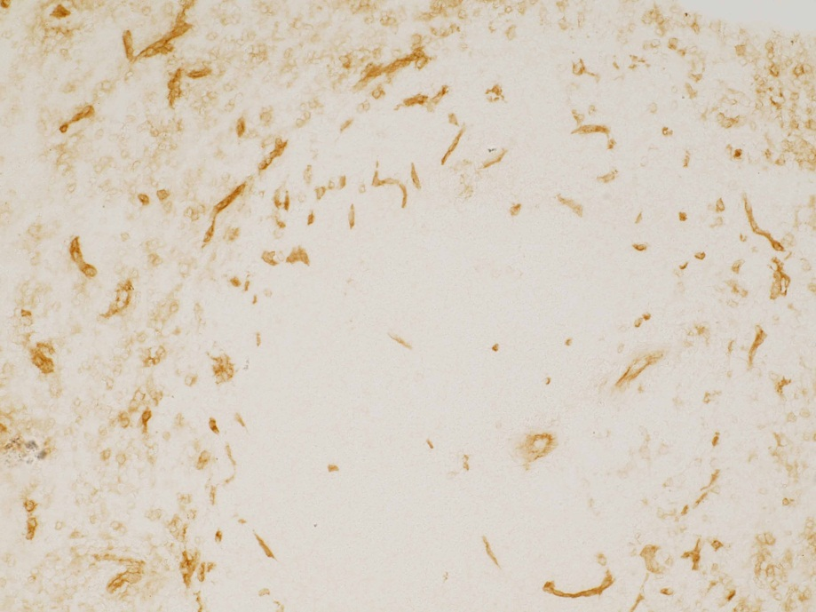
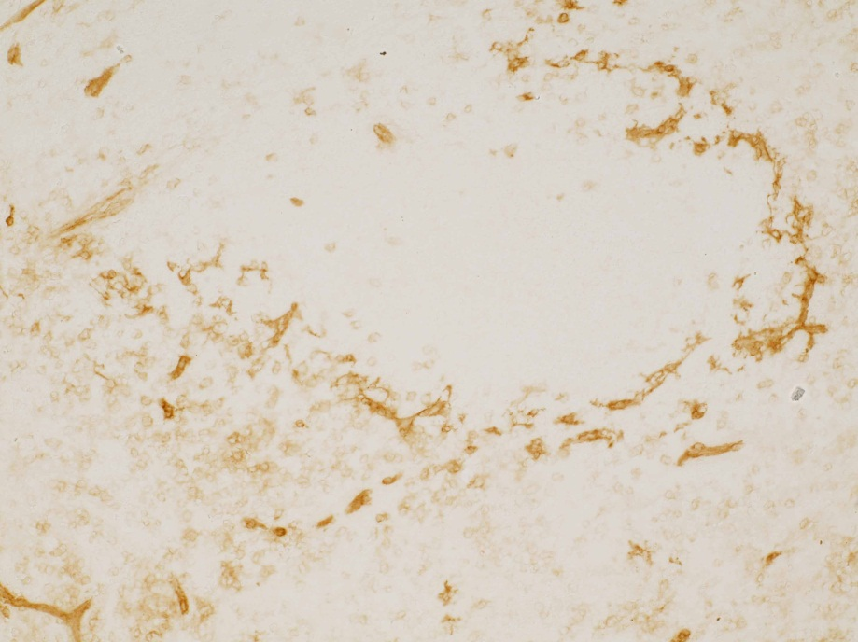
ReliaTech GmbH
Anti-human VEGFR-2/KDR
(Cryo section; Cat# 102-PA18S / -PA18)
Human Spleen
Anti-human VEGFR-2/KDR (Cat# 102-PA18S)
Human Spleen)
Anti-human VEGFR-2/KDR (Cat# 102-PA18S)
The experiment was performed by Prof. Dr. Birte Steiniger, Institute of Anatomy and Cell Biology Robert-Koch-Str. 8, D-35037 Marburg, Germany
http://www.reliatech.de / orders@reliatech.de

